Slide 1
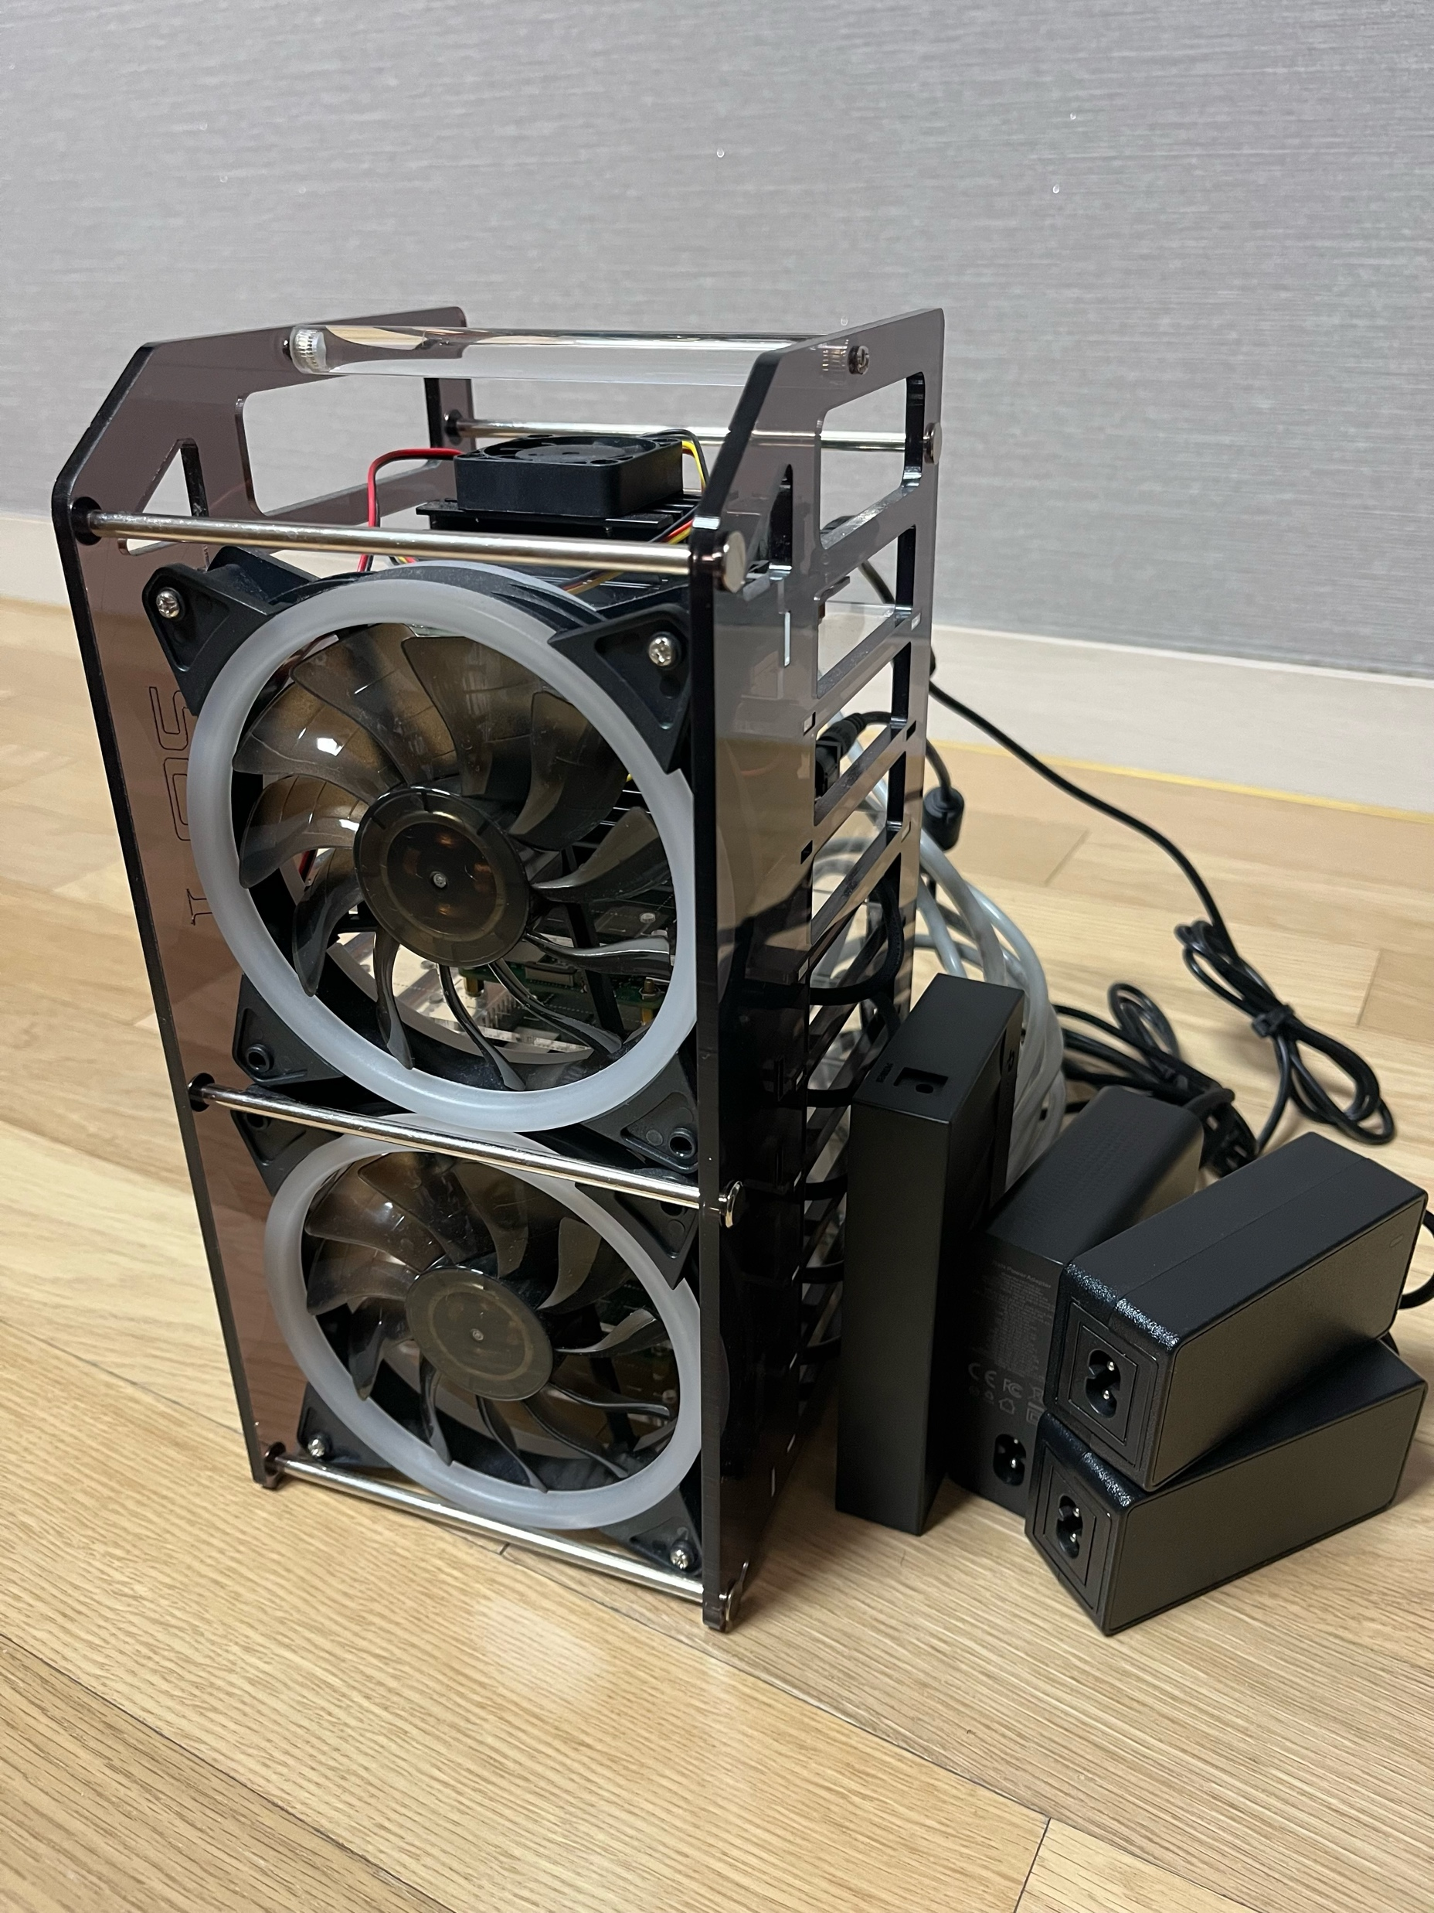
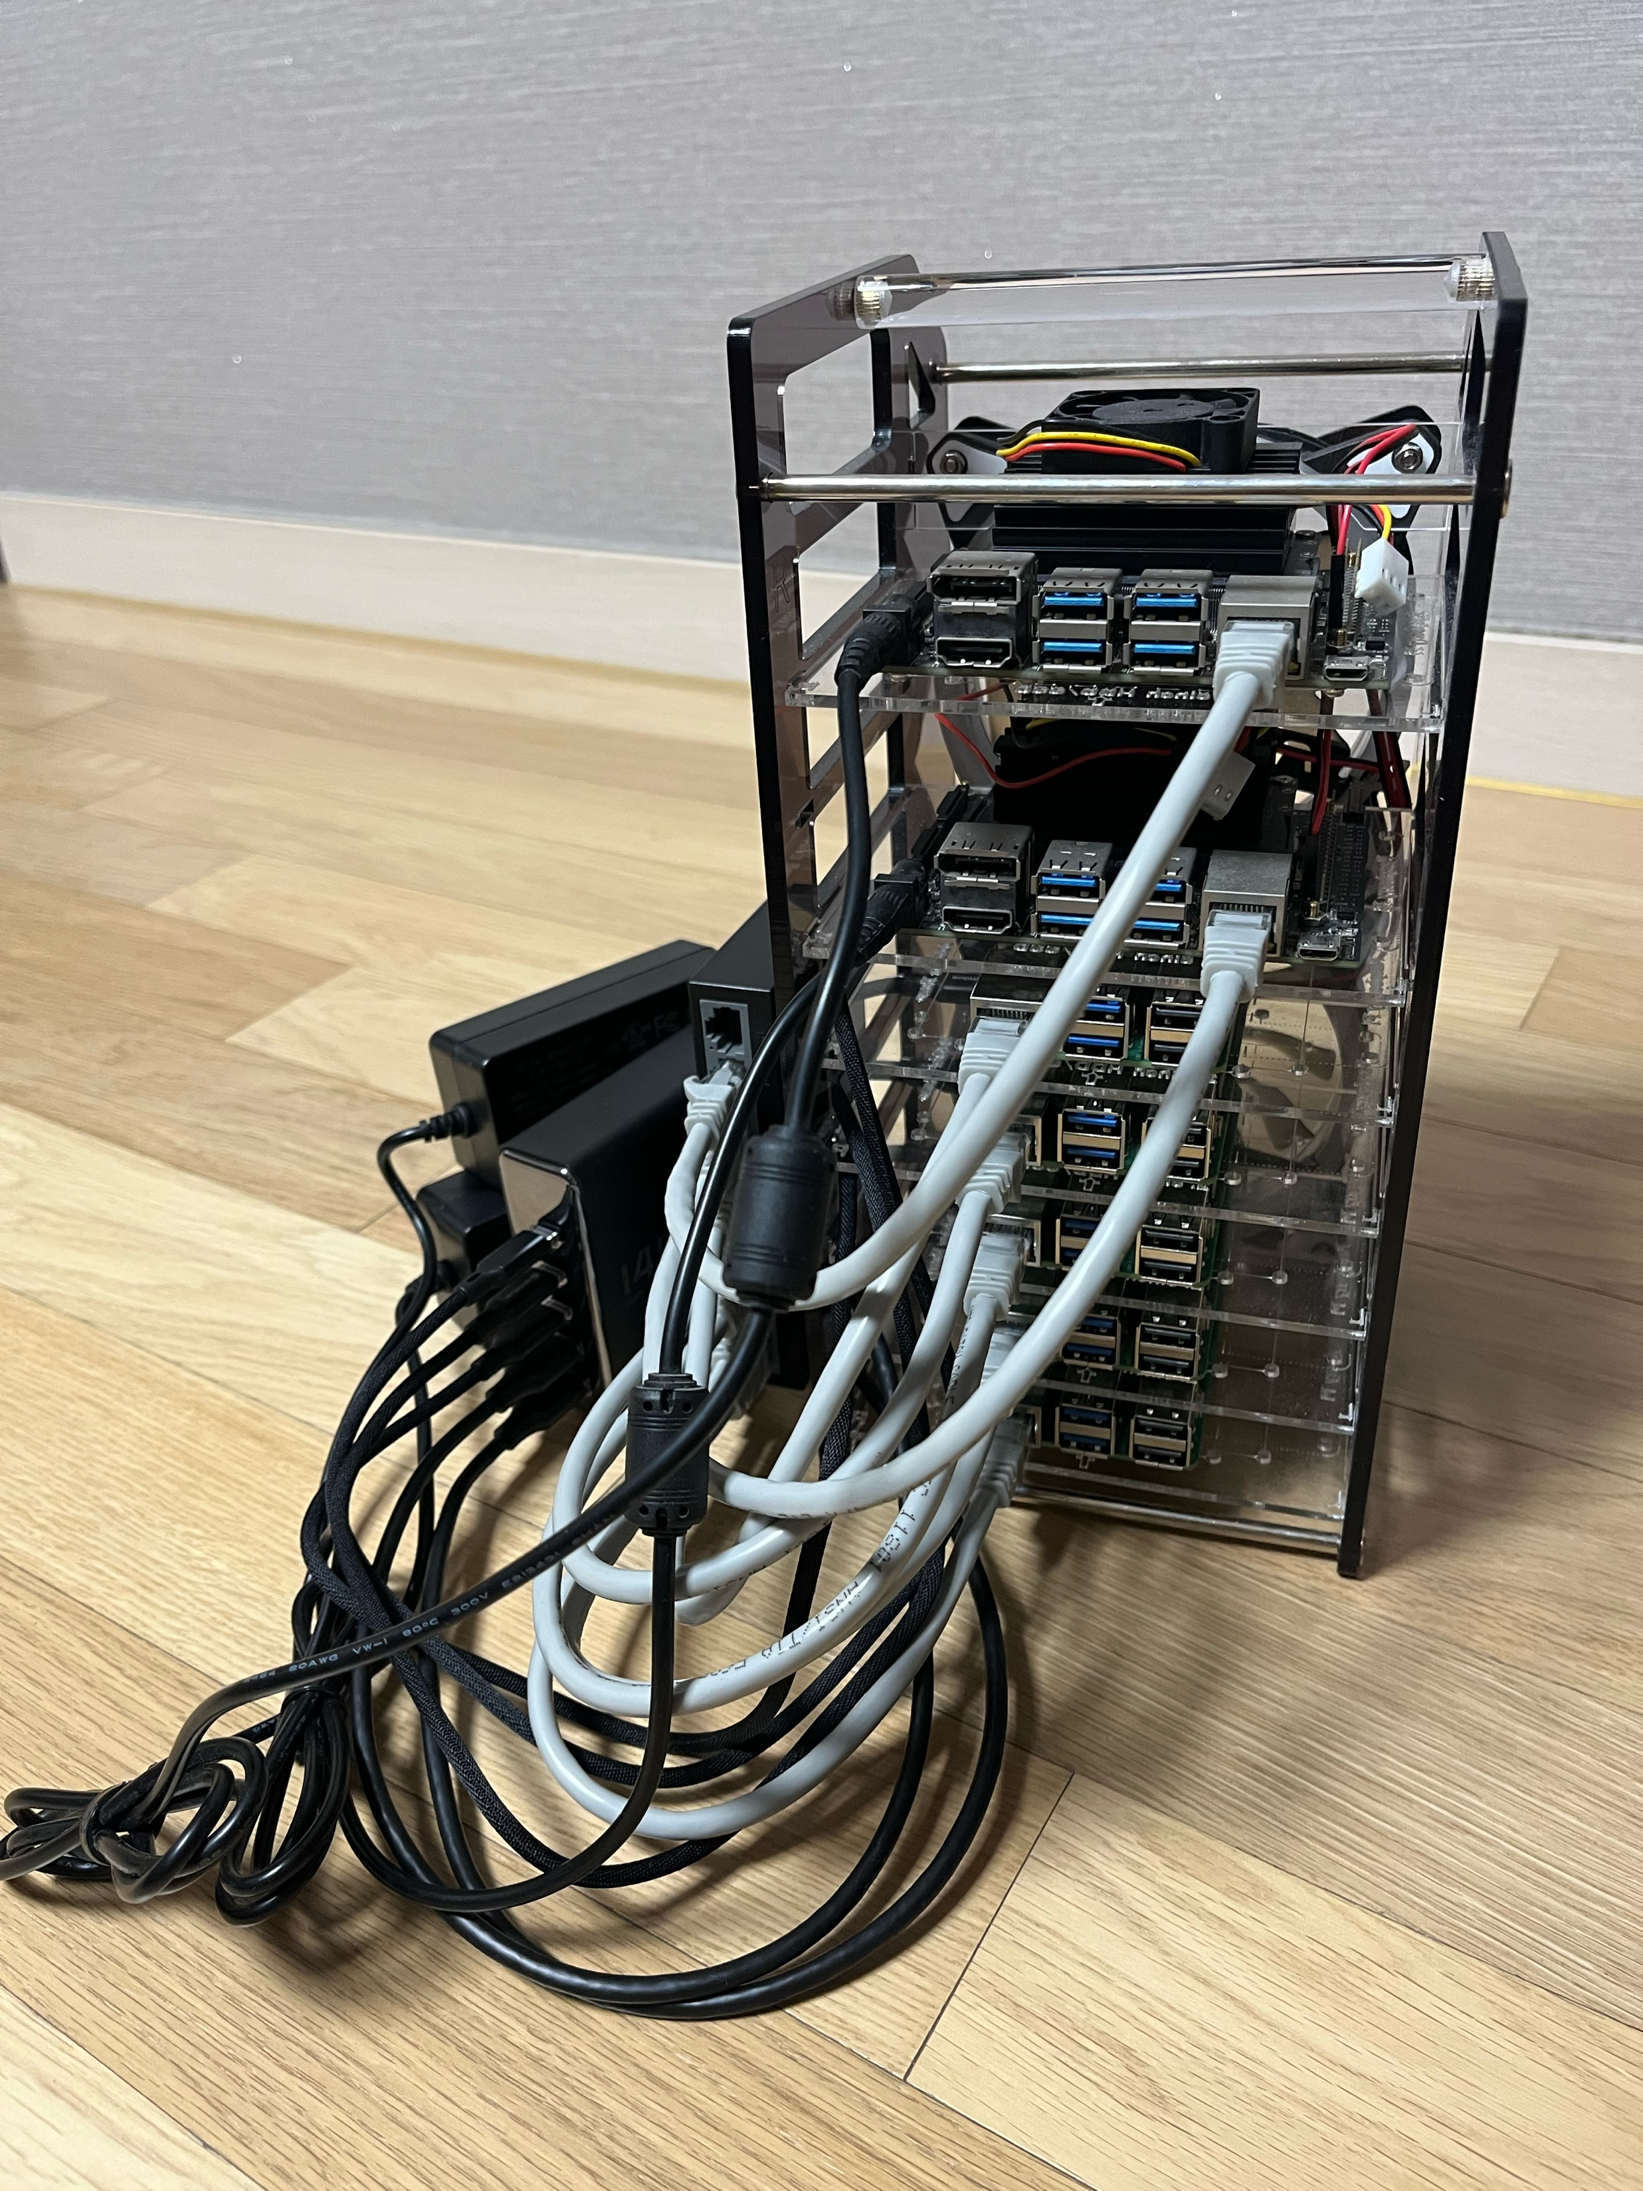

Slide 2
Worker Node Group
Worker Node 1 / Orange Pi 5 Max
CPU : 8 Core Memory : 16 GB
Storage : 128 GB
Network : 192.168.1.72
Worker Node 2 / Orange Pi 5 Max
CPU : 8 Core Memory : 16 GB
Storage : 128 GB
Network : 192.168.1.73
Worker Node 3 / Orange Pi 5 Max
CPU : 8 Core Memory : 16 GB
Storage : 128 GB
Network : 192.168.1.74
Master Node / Orange Pi 5 Max
CPU : 8 Core Memory : 16 GB
Storage : 512 GB
Network : 192.168.1.71
Worker Node 4 / Orange Pi 5 Max
CPU : 8 Core Memory : 16 GB
Storage : 128 GB
Network : 192.168.1.75
Worker Node 5 / Orange Pi 5 Max
CPU : 8 Core Memory : 16 GB
Storage : 128 GB
Network : 192.168.1.76
Worker Node 6 / Orange Pi 5 Max
CPU : 8 Core Memory : 16 GB
Storage : 128 GB
Network : 192.168.1.77

Slide 4
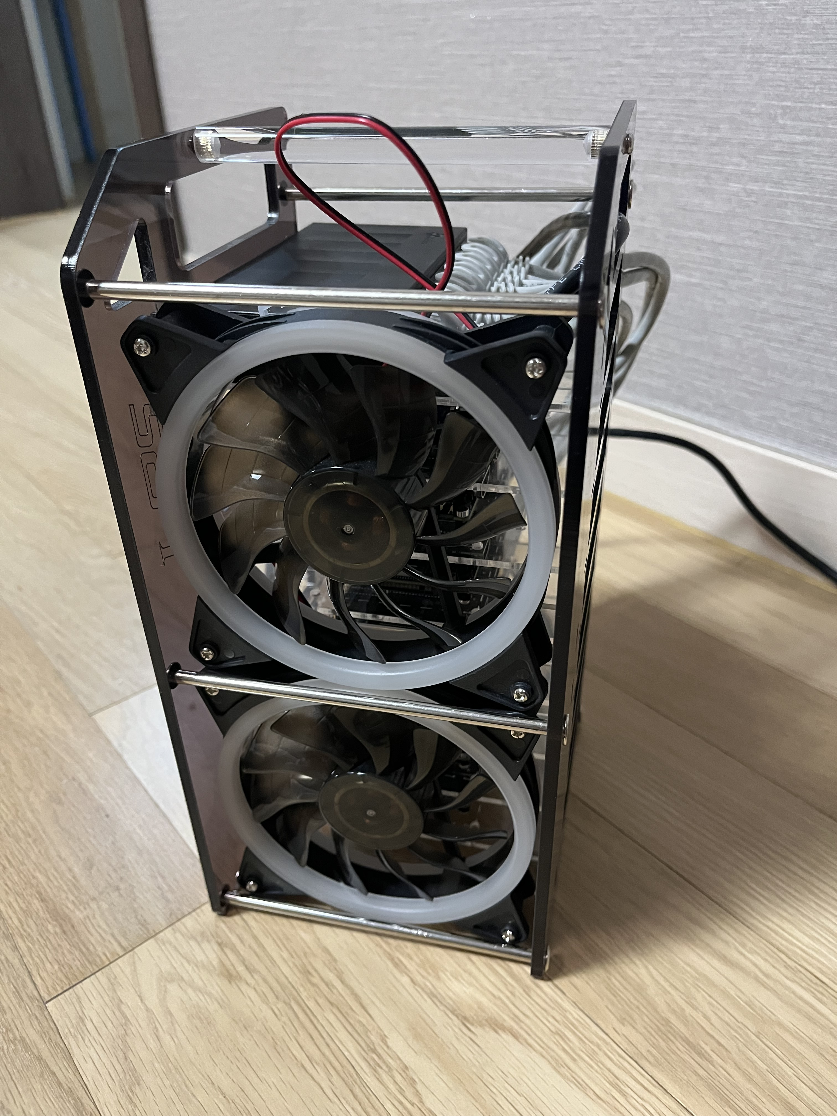
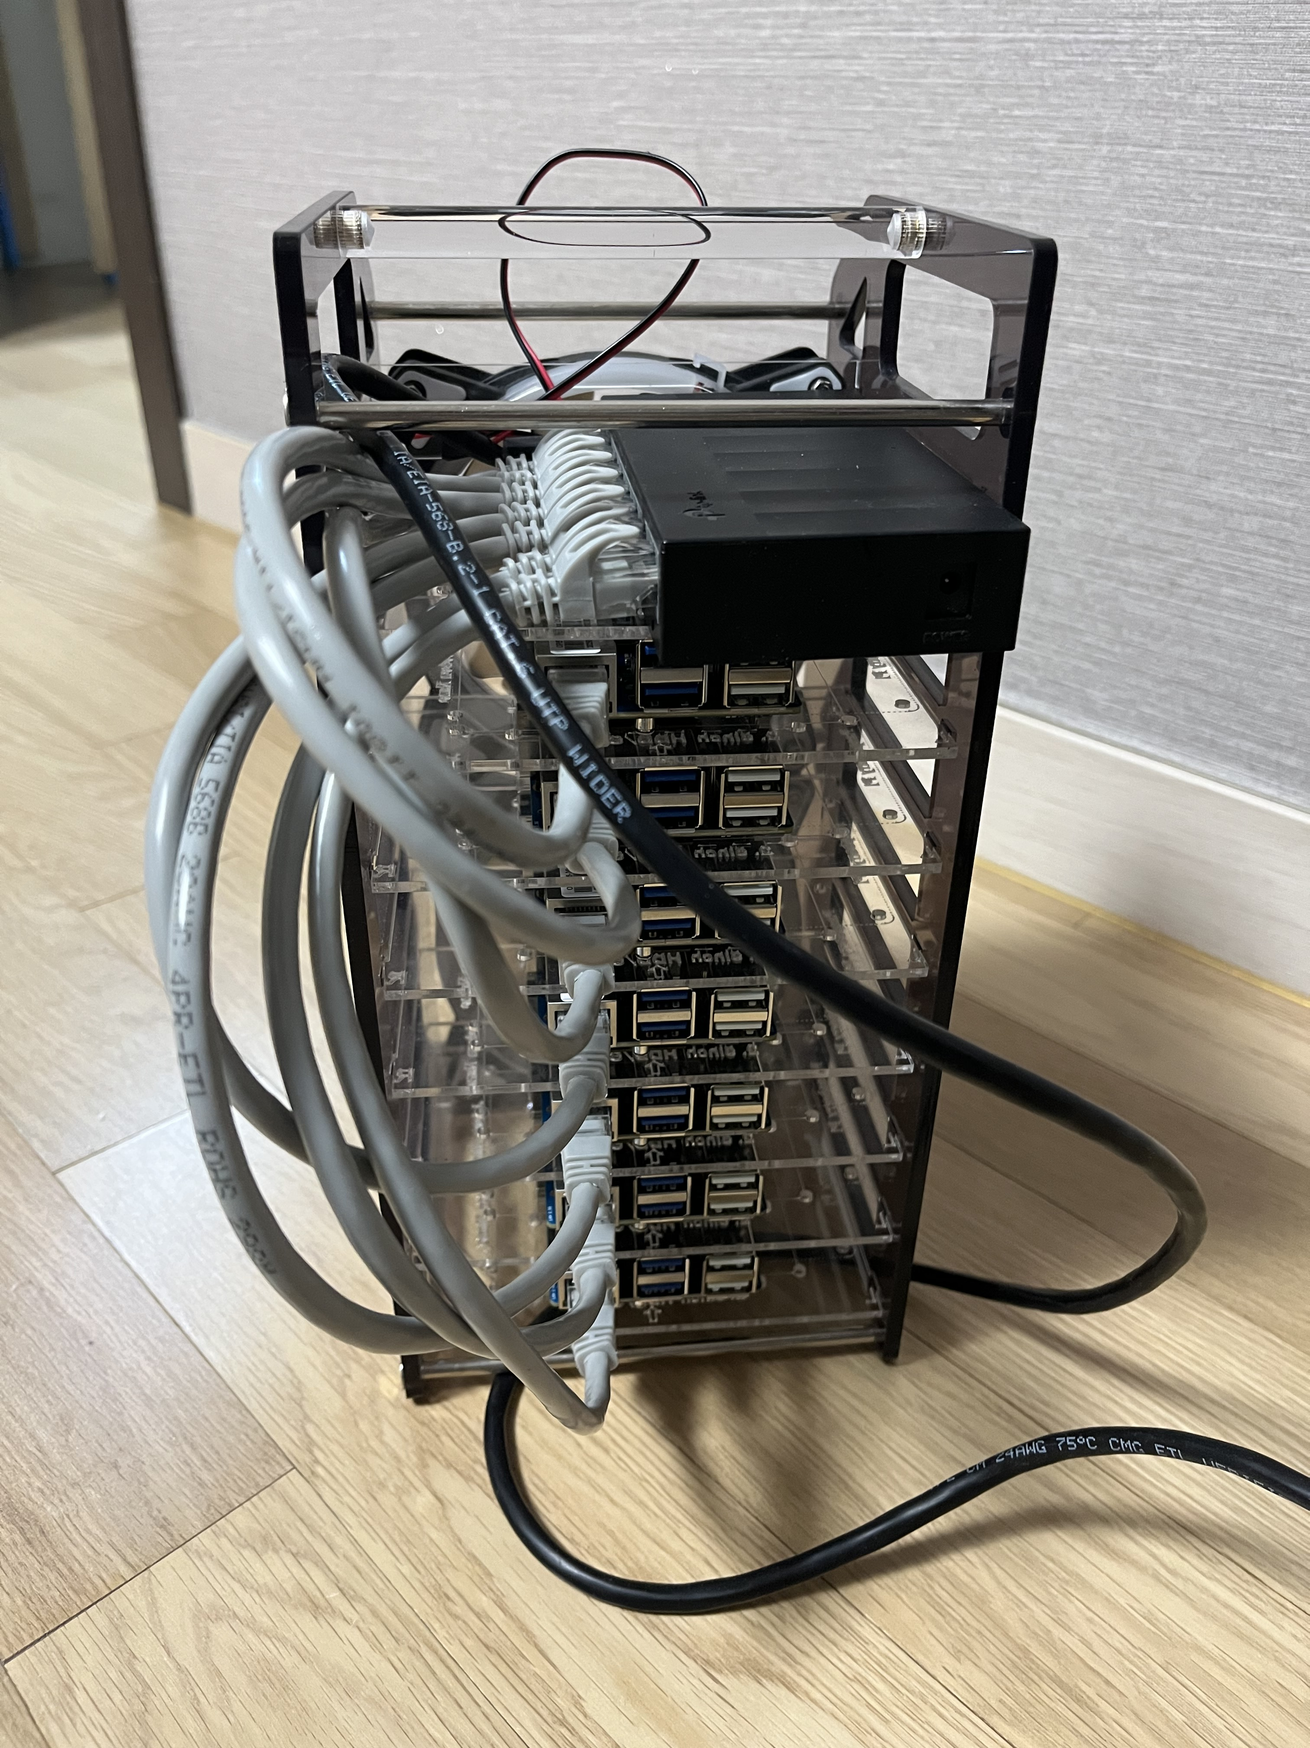

Slide 5
Worker Node Group
Storage Node Group
GPU Node Group
Worker Node 01 / Raspberry Pi 5
CPU : 4 Core Memory : 8 GB
Storage : 64 GB
Network : 192.168.4.42
Storage Node 01 / Raspberry Pi 5
CPU : 4 Core Memory : 8 GB
Storage : 256 GB
Network : 192.168.4.44
GPU Node 01 / Jetson Nano
CPU : 4 Core Memory : 4 GB
Storage : 64 GB
Network : 192.168.4.46
Master Node / Raspberry Pi 5
CPU : 4 Core Memory : 8 GB
Storage : 64 GB
Network : 192.168.4.41
Worker Node 01 / Raspberry Pi 5
CPU : 4 Core Memory : 8 GB
Storage : 64 GB
Network : 192.168.4.43
Storage Node 02 / Raspberry Pi 5
CPU : 4 Core Memory : 8 GB
Storage : 256 GB
Network : 192.168.4.45
GPU Node 02 / Jetson Nano
CPU : 4 Core Memory : 4 GB
Storage : 64 GB
Network : 192.168.4.47

Slide 6
Cluster
Master Node / Raspberry Pi 5
CPU : 4 Core Memory : 8 GB
Storage : 64 GB
Network : 192.168.4.41
etcd
Server
K8s API Server
K8s Controller Manager
K8s Scheduler
K8s
kubelet
K8s
kubelet

